Slide 1
OPEN ELECTIVE OCS1903-PROGRAMMING USING PYTHON WEEK 3 `

Slide 2
CONTENTS
Selection Control Structure
If
If- else
If elif ladder
Nested If

Slide 3
Decision making is anticipation of conditions occurring while execution of the program and specifying actions taken according to the conditions
Decision structures evaluate multiple expressions which produce TRUE or FALSE as outcome.
You need to determine which action to take and which statements to execute if outcome is TRUE or FALSE otherwise

Slide 4
Python interprets non-zero values as True. None (null) and 0 are interpreted as False.

Slide 5
Selection Control Structures
If
If-else
If-elif-else ladder
Nested If-else

Slide 6
Conditionals Type
Statement | Description
conditional (if) | if statement consists of a boolean expression followed by one or more statements
alternative (if…else) | if statement can be followed by an optional else statement, which executes when the boolean expression is FALSE
chained conditional (The elif Statement ) | The elif is short for else if. It allows us to check for multiple expressions.
nested conditional (nested if statements) | use one if or else if statement inside another if or else if statement(s)

Slide 7
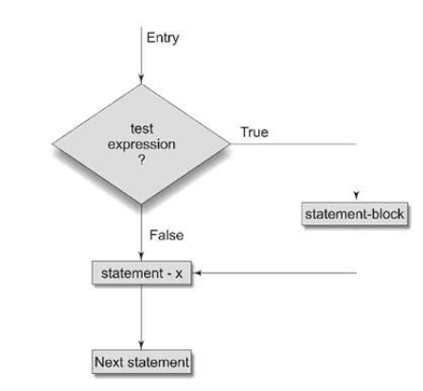
conditionals (if)`
The if statement contains a logical expression using which data is compared and a decision is made based on the result of the comparison
Syntax
if(test-expression):
statement-block(s)
statement-x

Slide 8
the program evaluates the test expression and will execute statement(s) only if the test expression is True.
In Python, the body of the if statement is indicated by the indentation.
The body starts with an indentation and the first unindented line marks the end.

Slide 9
Example Programs
Program 1:
value = float(input("Enter the Bike Kilometeres:"))
if(value > 2500):
print("Need to Change Bike Oil")
Program 2:
amount = float(input("Enter the amount:"))
if(amount > 40000):
print("Your Daily withdrawl amount exceeds the limit")

Slide 10
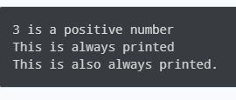
Example Programs
# If the number is positive, we print an appropriate message
num = 3
if num > 0:
print(num, "is a positive number.")
print("This is always printed.")
num = -1
if num > 0:
print(num, "is a positive number.")
print("This is also always printed.")

Slide 11
alternative (if..else)
A second form of the if statement is ‚alternative execution, in which there are two possibilities and the condition determines which one runs.
An else statement can be combined with an if statement. An else statement contains the block of code that executes if the conditional expression in the if statement resolves to 0 or a FALSE value.
The else statement is an optional statement and there could be at most only one else statement following if.

Slide 12
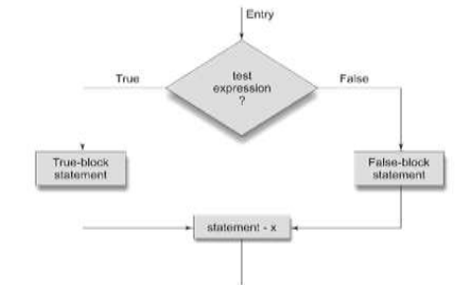
Syntax:
if(test-expression):
true-block-statement(s)
else:
false-block-statement(s)
statement-x

Slide 13
The if..else statement evaluates test expression and will execute the body of if only when the test condition is True.
If the condition is False, the body of else is executed. Indentation is used to separate the blocks.

Slide 14
Example Programs
Program 1:
value = float(input("Enter the Bike Kilometeres:"))
if(value > 2500):
print("Need to Change Bike Oil")
else:
print("You can ride upto 2500 Kilometers! to change Bike Oil")
Program 2:
amount = float(input("Enter the amount:"))
if(amount > 40000):
print("Your Daily withdrawl amount exceeds the limit")
else:
print("Successfully Withdrawl the amount")

Slide 15
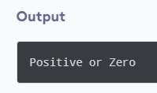
Example Programs
# Program checks if the number is positive or negative
# And displays an appropriate message
num = 3
if num >= 0:
print("Positive or Zero")
else:
print("Negative number")

Slide 16
chained conditional (The elif Statement)
Sometimes there are more than two possibilities and we need more than two branches.
One way to express a computation like that is a chained conditional.
The elif statement allows you to check multiple expressions for TRUE and execute a block of code as soon as one of the conditions evaluates to TRUE.
Similar to the else, the elif statement is optional

Slide 17
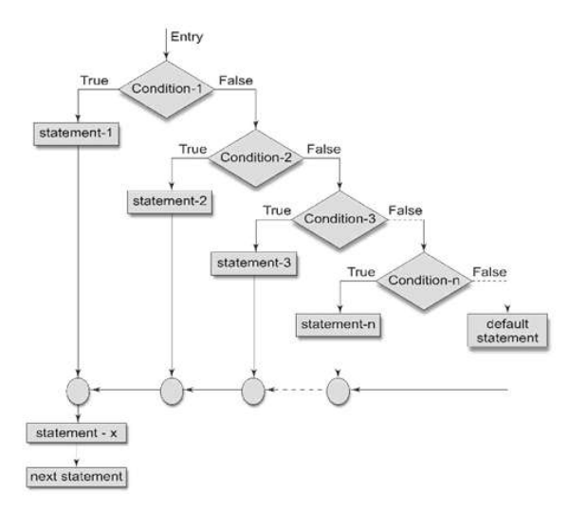
Syntax
if(test-condition-1):
statement-1
elif(test-condition-2):
statement-2
. . .
. . .
elif(test-condition-n):
statement-n
else:
default-statement
statement-x

Slide 18
The elif is short for else if. It allows us to check for multiple expressions.
If the condition for if is False, it checks the condition of the next elif block and so on.
If all the conditions are False, the body of else is executed.
Only one block among the several if...elif...else blocks is executed according to the condition.
The if block can have only one else block. But it can have multiple elif blocks.

Slide 19
Example Programs
color = int(input("Enter the Color:"))
if color == 1:
print("Violet Color")
elif color == 2:
print("Indigo Color")
elif color == 3:
print("Blue Color")
elif color == 4:
print("Green Color")
elif color == 5:
print("Yellow Color")
elif color == 6:
print("Orange Color")
elif color == 7:
print("Red Color")
else:
print("Invalid Color Entry!")

Slide 20
Example Programs
'''In this program, we check if the number is positive or
negative or zero and display an appropriate message'''
num = 3.4
if num > 0:
print("Positive number")
elif num == 0:
print("Zero")
else:
print("Negative number")

Slide 21
nested conditional (nested if Statement)
One conditional can also be nested within another

Slide 22
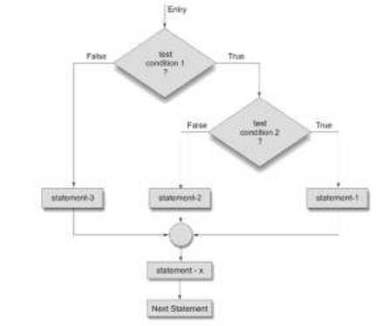
Syntax
if(test-condition-1):
if(test-condition-2):
statement-1
else:
statement-2
else:
statement-3
statement-x

Slide 23
We can have a if...elif...else statement inside another if...elif...else statement. This is called nesting in computer programming.
Any number of these statements can be nested inside one another. Indentation is the only way to figure out the level of nesting. They can get confusing, so they must be avoided unless necessary.

Slide 24
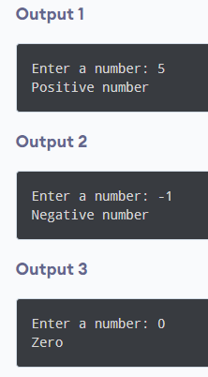
Example Programs
'''In this program, we input a number check if the number is positive or
negative or zero and display an appropriate message. This time we use nested if statement'''
num = float(input("Enter a number: "))
if num >= 0:
if num == 0:
print("Zero")
else:
print("Positive number")
else:
print("Negative number")

Slide 25
Example Programs
num1 = int(input("Enter First Number:"))
num2 = int(input("Enter Second Number:"))
num3= int(input("Enter Third Number:"))
if(num1 > num2):
if(num1 > num3):
print("Number 1 is largest")
else:
print("Number 3 is largest")
else:
if(num2 > num3):
print("Number 2 is largest")
else:
print("Number 3 is largest")

Slide 26


